Slide 1
Franciscan Spirituality
Following in the Footprints of St Francis of Assisi

Slide 2
Why Are We Here? Why Francis?
Adult education has been a request from my first days here.
Positive response to the results of the Church's Synodal process.
"Franciscan" parish: leaders share their spiritual tradition...."charism"
Francis offers a way of seeking God that is accessible, practical, universal
Search for meaning/purpose: Gospel through the Church in the spirit of Francis.

Slide 3
Spirituality: "Theology on Two Feet"
Every Christian spirituality is an expression about:
God. (Theology)
What it means to be a human being. (Anthropology)
The way/journey the human person is united with the Divine.
For the Christian, Christ is the way to enter into God.
Our actions toward our neighbors are a gauge of our love of God.
Our struggles to love God offer insights to seek God's presence.
Spirituality/Morality: desire to live a life well-pleasing to God.

Slide 4
Religious Life: Monks and Mendicants
A gift born out of the mystery of the Church:
Begun in the East, Antony of Egypt, Desert Fathers/Mothers
Canonically erected by the Church.
Life of prayer is the liturgy of the Church
Public profession of poverty, chastity, obedience (Counsels)
Life lived in common.
St. Benedict (500 AD): Rule of Life for Monte Casino.
Saved Western civilization
Vow of Stability to one's monastery, an immoveable structure
Monastery supported through prayer and work...ora et labora
Notes:
00

Slide 5
The Thirteenth Century:
The Church is at the apex of its religious & civil power.
"The Church is Europe and Europe is the Church." Hilaire Belloc
"The Catholic Century"
Pope Innocent III: most(?) powerful Pope in history.
Claimed primacy over all kings and royalty in Europe.
Europe in radical societal change.
First return to the cities since the fall of Rome, 700 years before.
Universities forming in Bologna, Paris, Siena, Cambridge, Padua, Spain
The beginnings of a merchant "middle" class, trade guilds
Beginning to move from "Romanesque" to "Gothic."

Slide 7
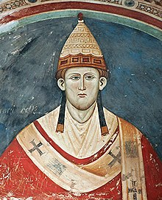
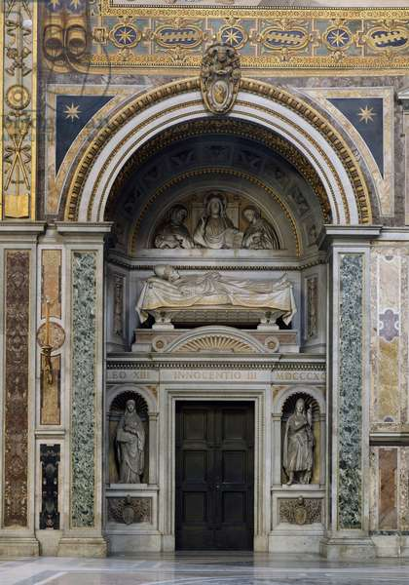

Slide 8
Greatest council of the Middle Ages. Major liturgical and calendar changes. New restrictions on religious life – no new "rules."
"Lateran IV"
November, 1215

Slide 10
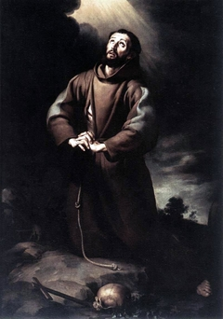
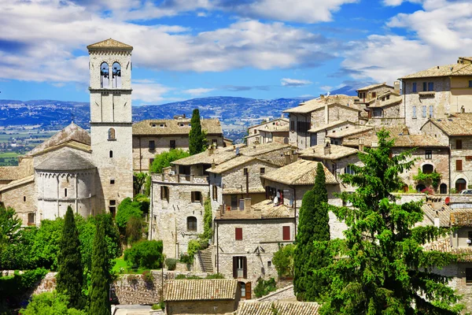
Giovanni Baptista Bernadone 1181/2 – 1226 Pietro Bernadone Pica of Bourlemont “Francesco”

Slide 11
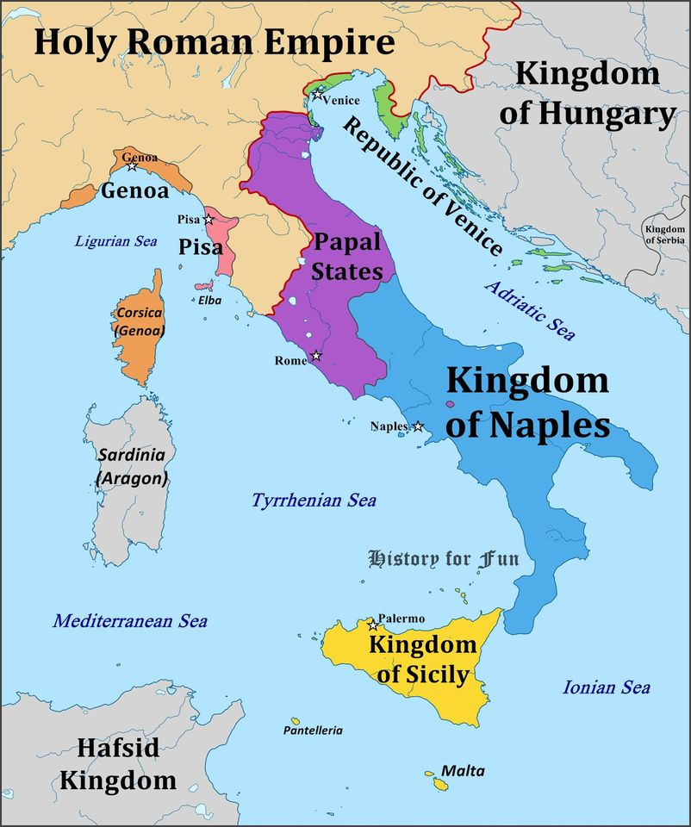

Slide 12
The Dream... A Knight in armor
To go bravely into battle and conquer the neighboring city of Perugia for the honor of glory of Assisi.

Slide 13
The Reality...

Slide 15
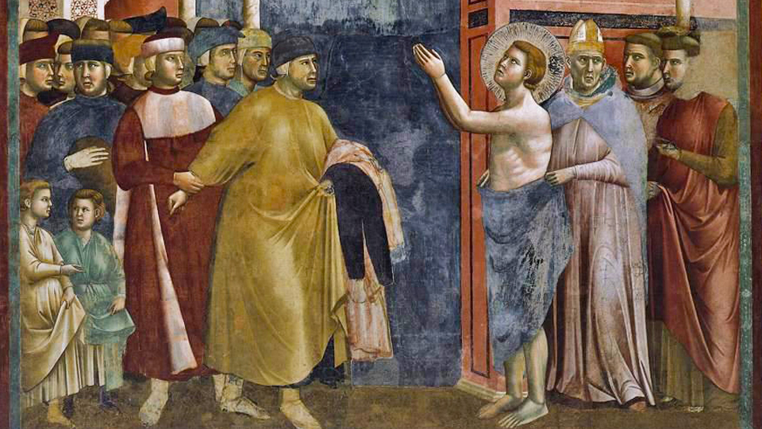
Francis renounces his father and patrimony.
Pietro, furious that Francis is giving business funds to the poor, demands that the funds be returned.
In the town square before the Bishop and the people, Francis renounces his father: "I have one Father who is in heaven."

Slide 17
Add a Slide Title - 4

Slide 18
Add a Slide Title - 4

Slide 19
Add a Slide Title - 5

Slide 20
Add a Slide Title - 6

